Slide 1
Bandgap Reference (BGR)
Presented by
Madhukar saini

Slide 2
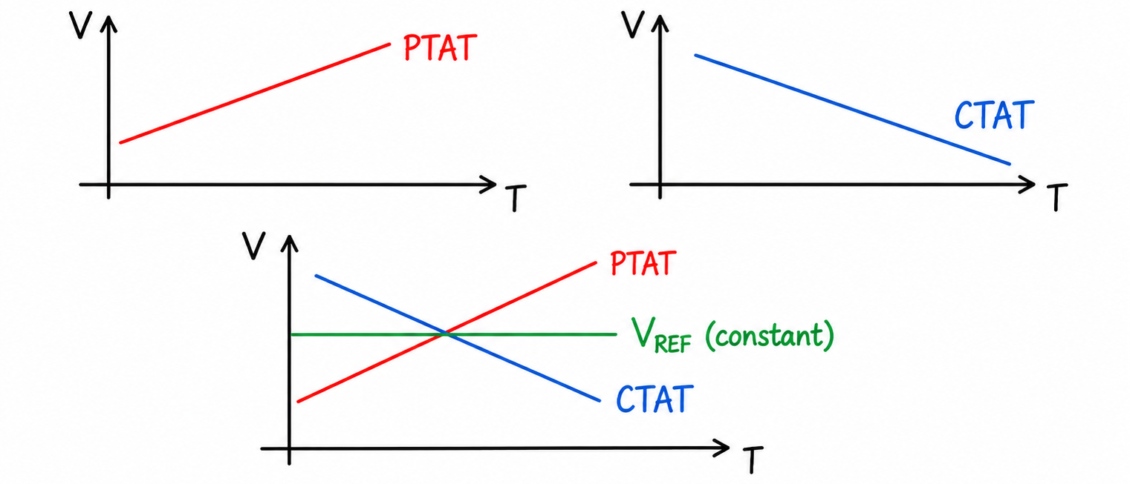
Band Gap Reference (BGR)
BGR produces constant voltage independent of Process, Voltage and Temperature (PVT)
Note : Any slope of PTAT + any slope of CTAT is not equal to constant V_{REF}

Slide 3
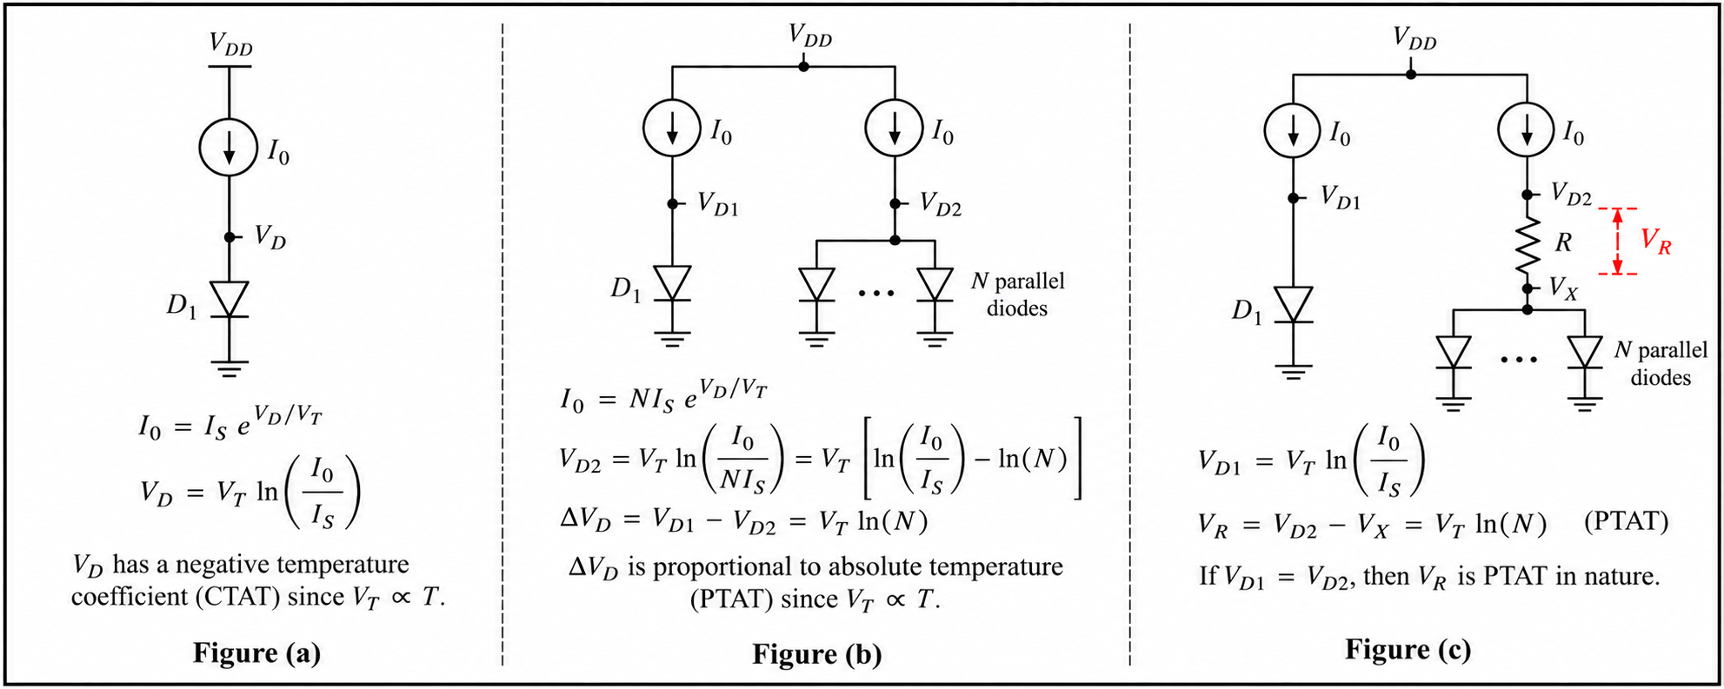
BGR Circuit implementation

Slide 4
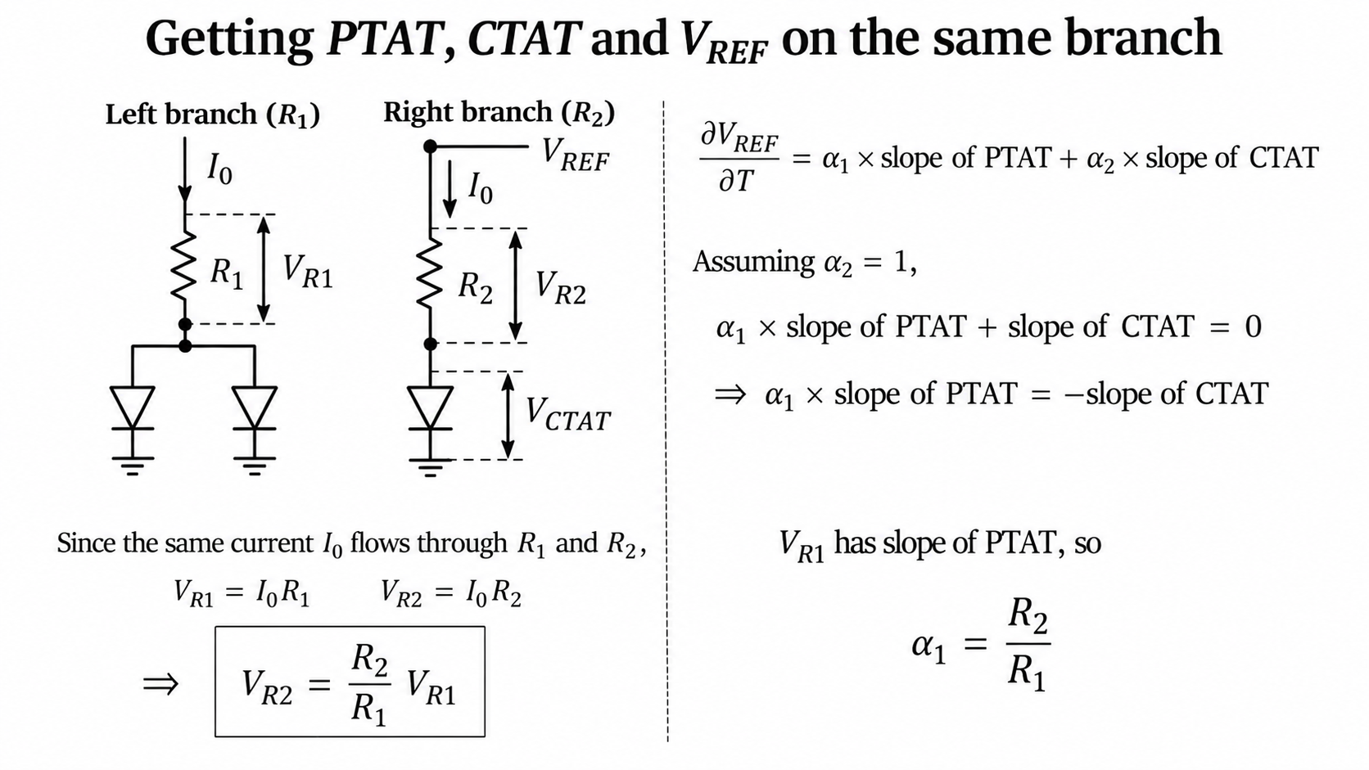
Getting PTAT, CTAT and V_{REF} on the same branch

Slide 5
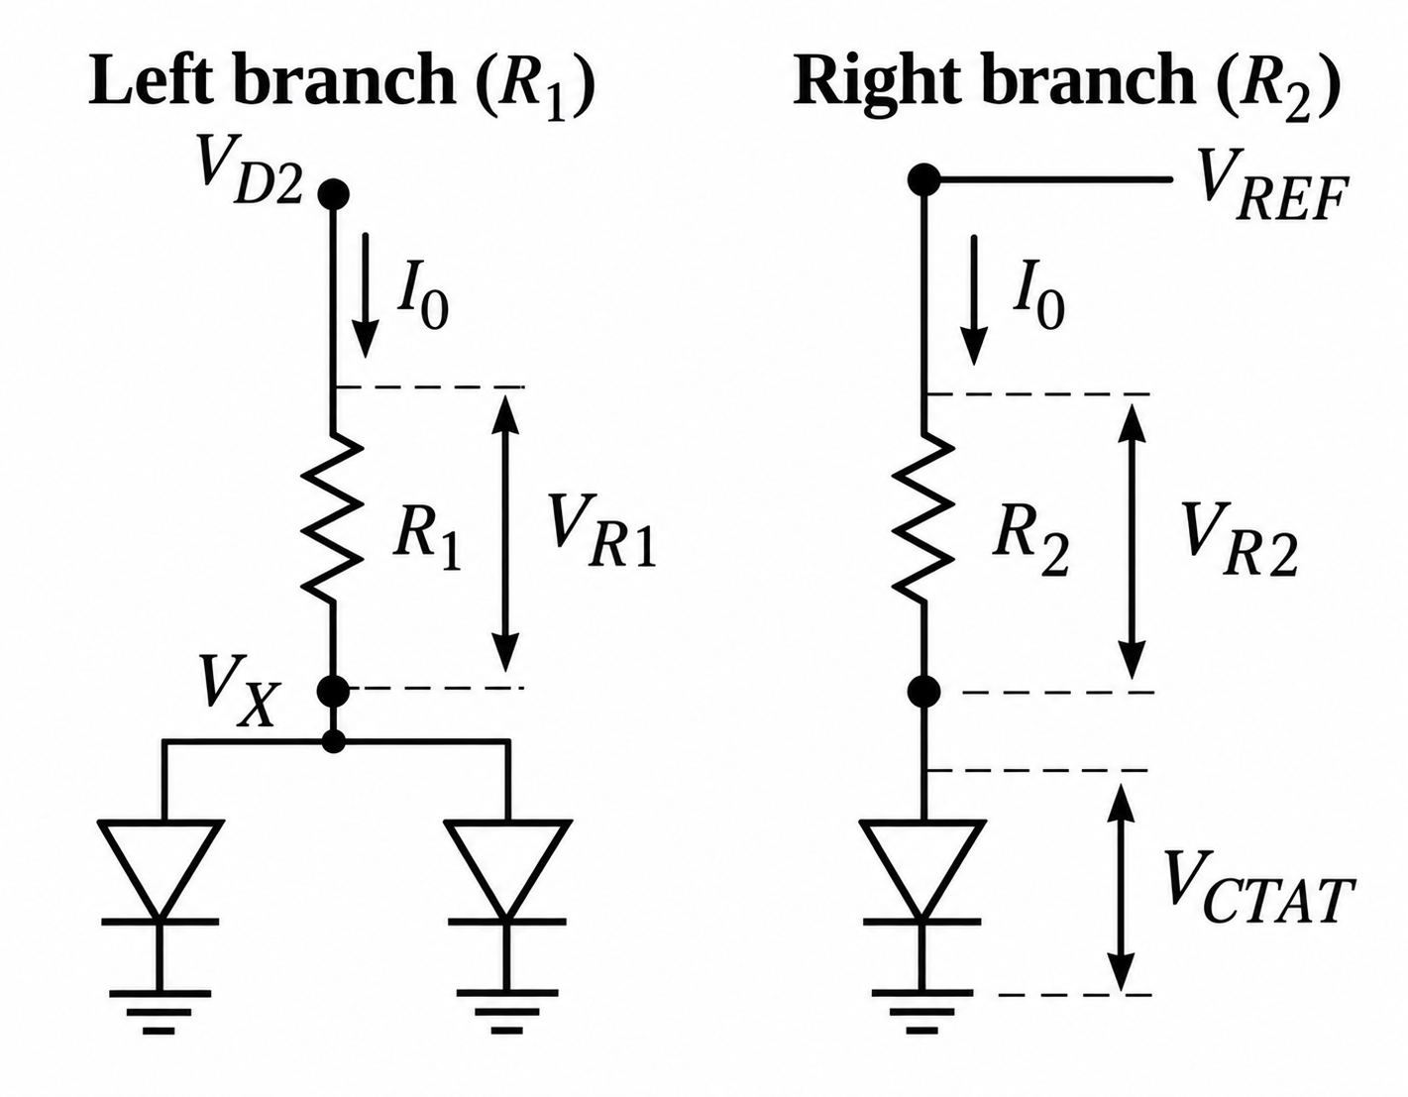
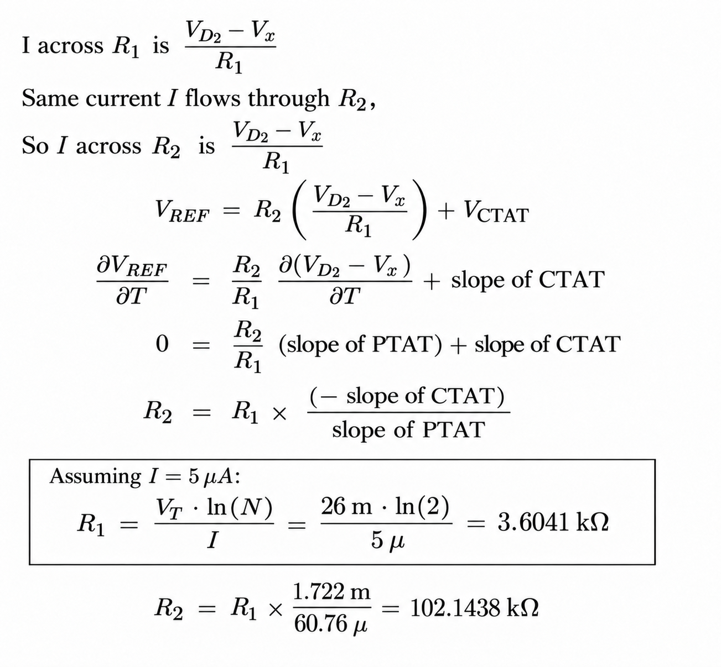
Calculation of R1 and R2

Slide 6
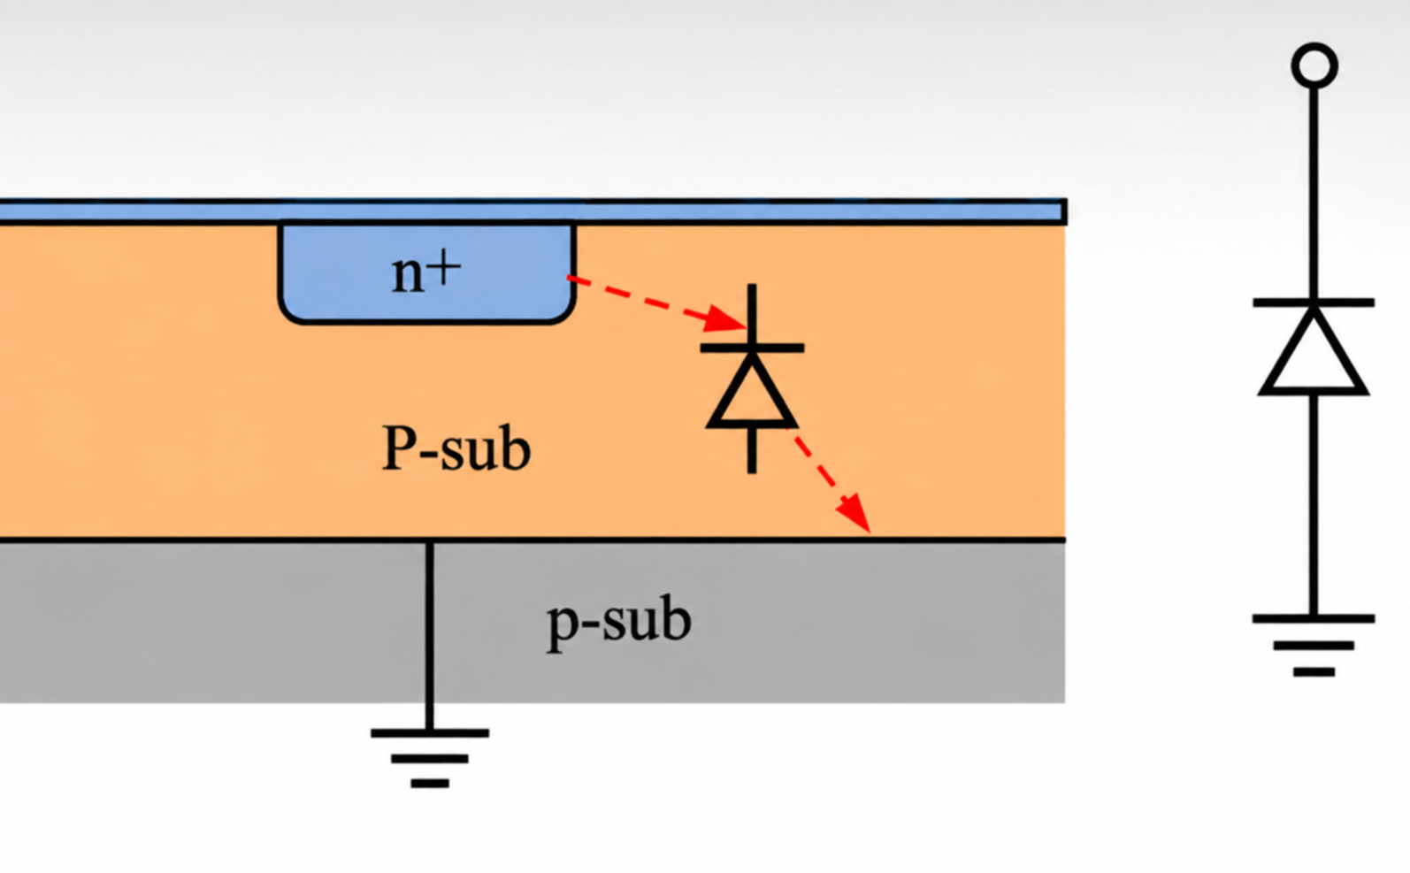
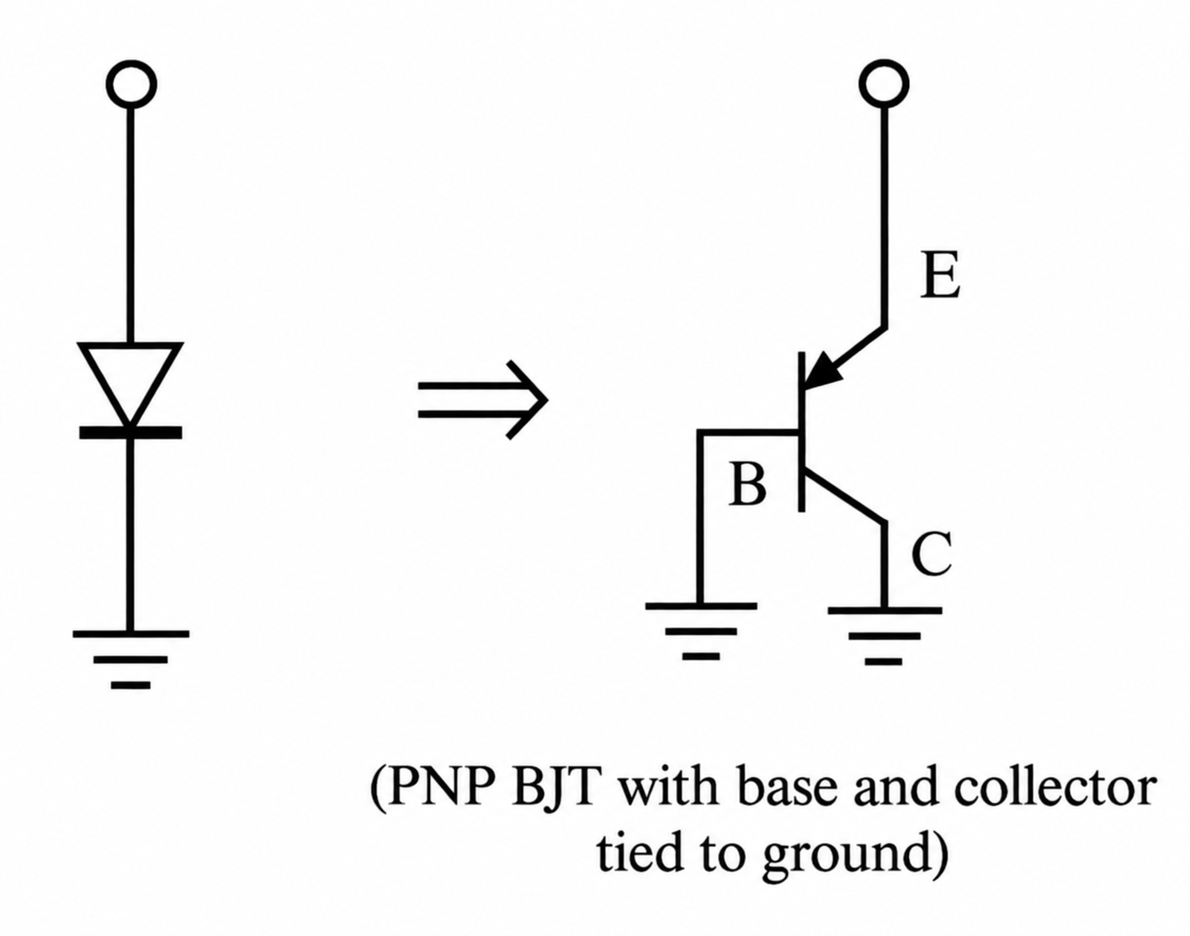
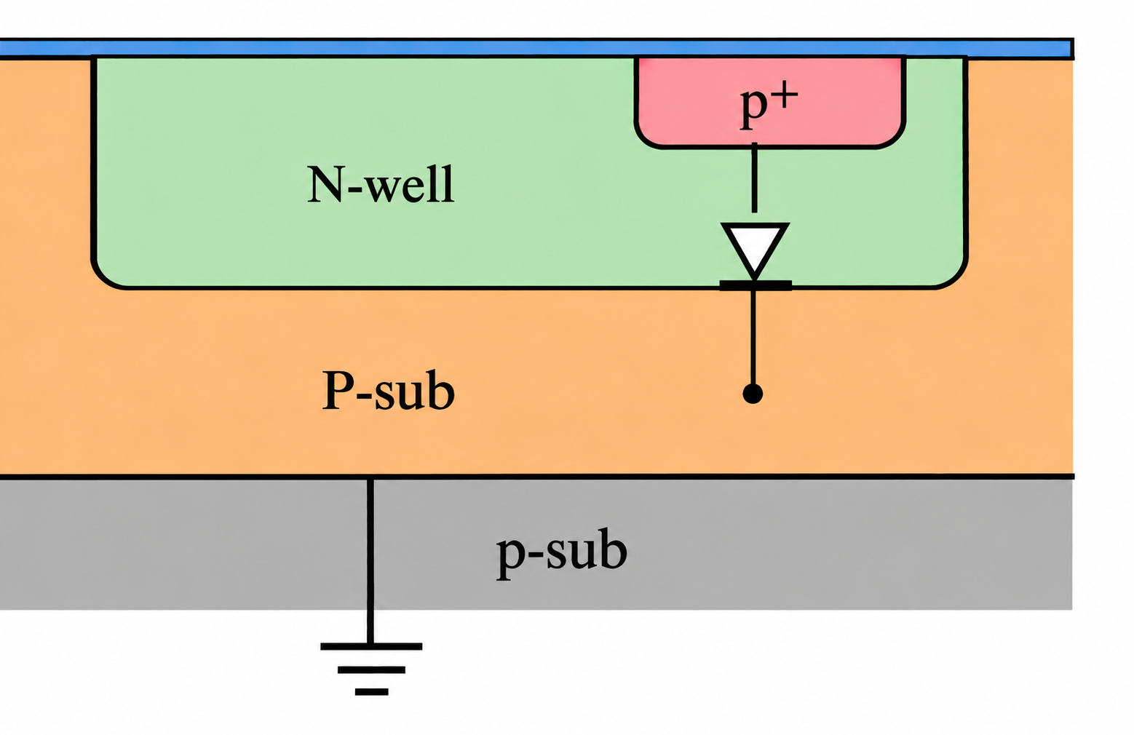
Why the BJT implemented in IC’s in the place of Diodes
Generally P-Sub connected to ground in IC’s, so this will not produce the operation we want in BGR
PNP-BJT replaces the Diode

Slide 7
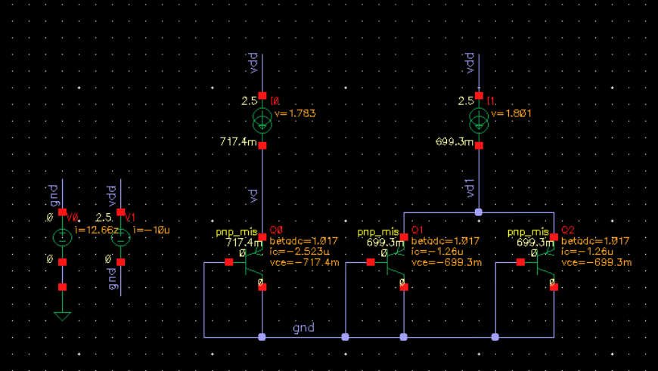
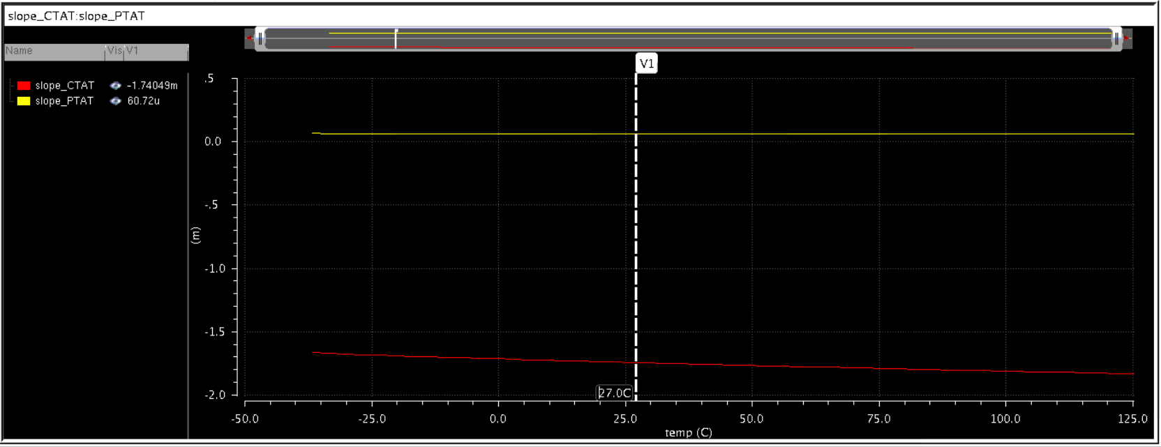
Calculation of CTAT and PTAT slopes (in the tool)
From the simulation for the biased current(I0) 5uA, the slopes of CTAT is -1.74mV/C and PTAT(N=2) is 60.72uV/C at room temperature

Slide 8
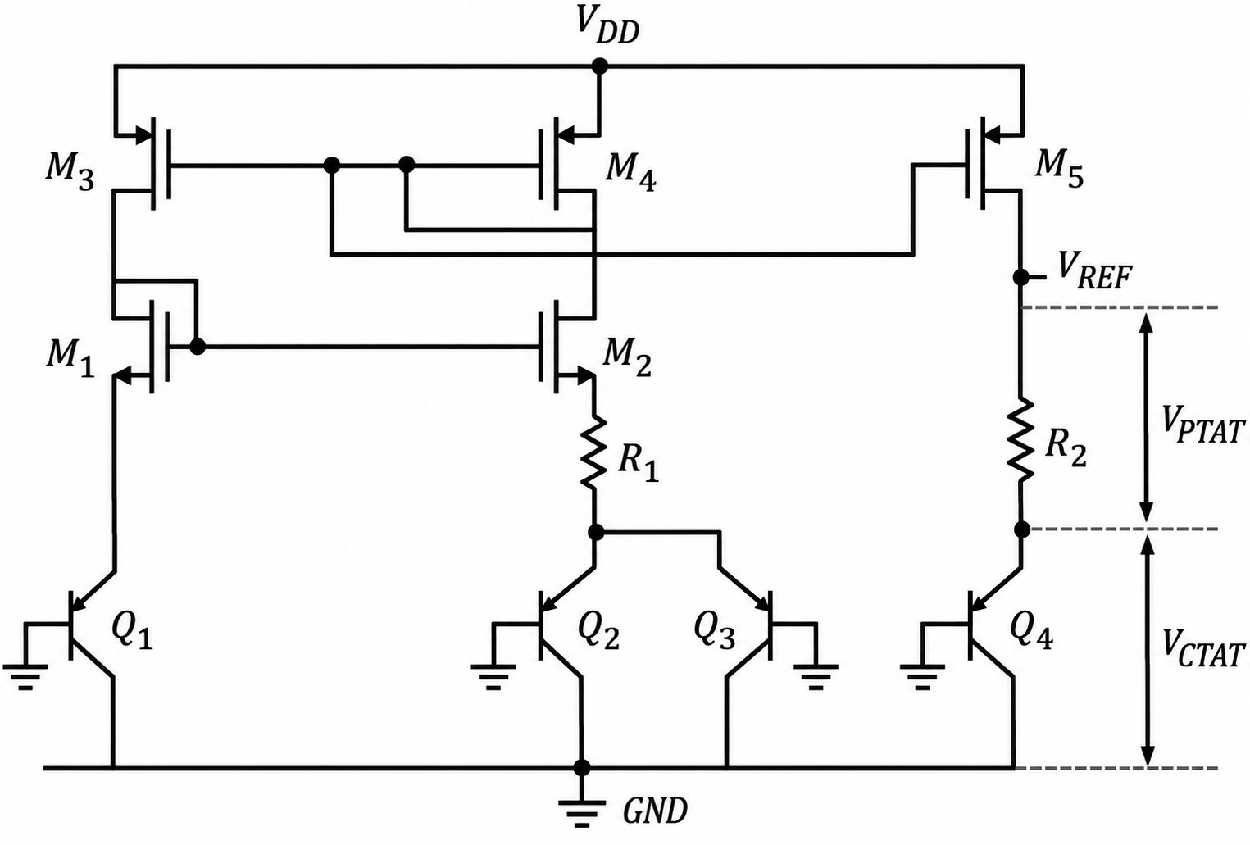
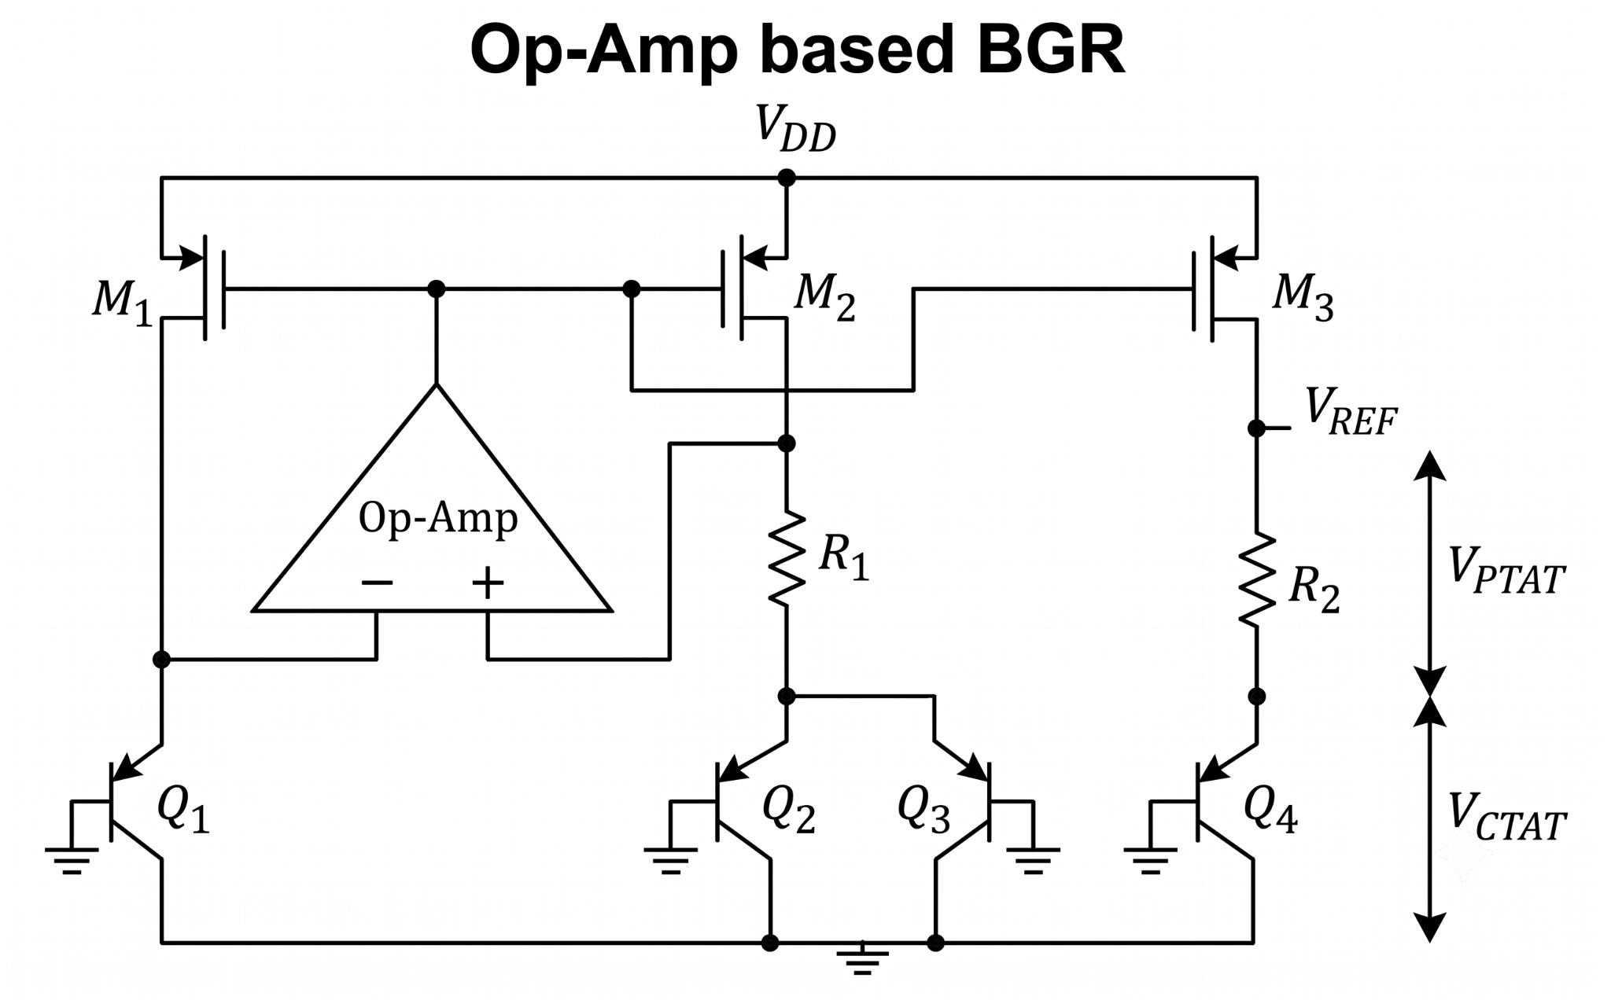
Making V_{D1} - V_{D2} and Current same in both the ends
To make V_{D1} - V_{D2} we generally we go with i) Current Mirror based BGR, ii) OP-Amp based BGR
Current Mirror based BGR
Op-Amp based BGR

Slide 9
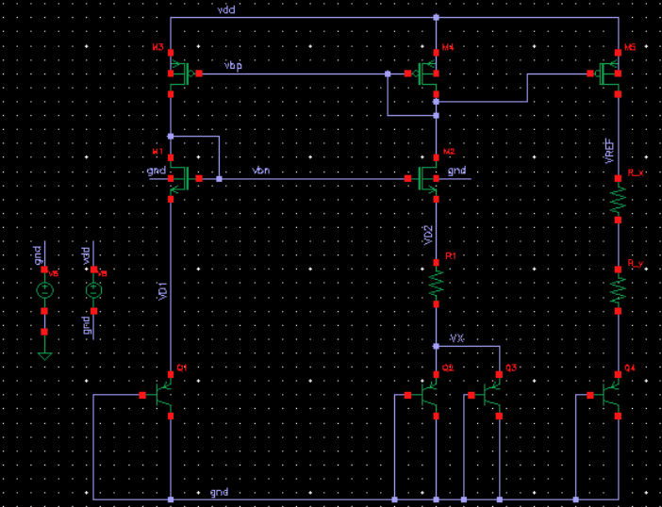
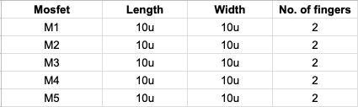
Current Mirror based BGR
Combinedly R2 that we discussed
Here the sizes of Mosfets are as follows
Here
R1 = 3.6038KΩ
R2 = R_x+R_y = 93.6533KΩ+1.20127KΩ

Slide 10
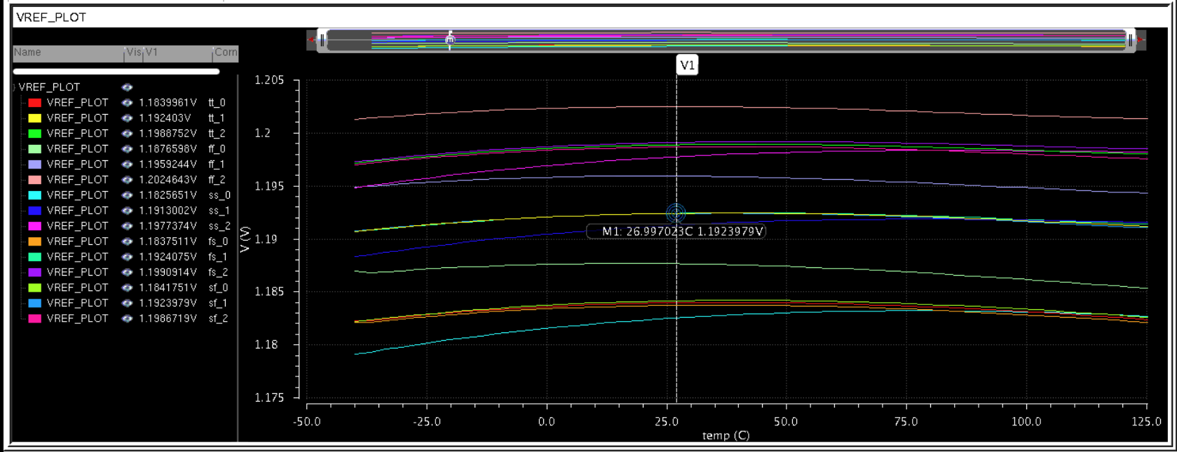
Simulation - DC (Current Mirror based BGR)
VREF is varying less than 1% across PVT from its typical value 1.192V in tt_27C_2.5V corner

Slide 11
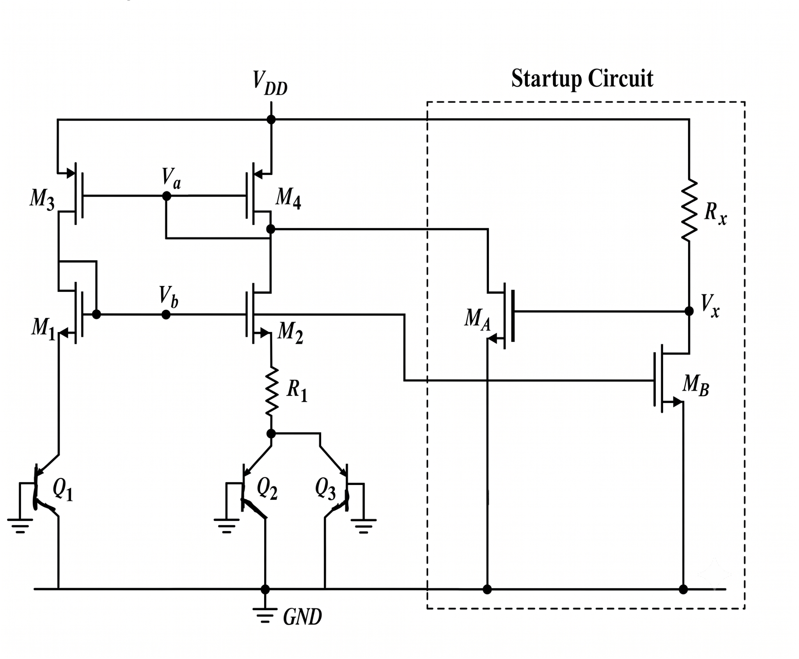
Startup - Current Mirror based BGR
During input ramp if gate of PMOS stays at VDD and NMOS stays at Ground, we will see startup problem. (i.e., V_{D1} = V_{D2} and I₀ on both side is zero)
To overcome this problem we need a startup circuit, that should disturb zero current bias point, during the supply ramp.
Let's say we have zero current in the beginning, that will make V_{a} → VDD,
V_{b} → zero and V_{x} → VDD. So M_{A} willbe diode connected to VDD and M_{B} is OFF. When supply ramp ups both V_{x},V_{a} decreases and V_{b} increase, making M_{B} ON and both V_{x}, V_{a} will make M_{A} OFF

Slide 12
Things should be cared in startup
R_{x} should be adjusted such that M_{A} wont draw much current from V_{a} node, so that current through R₁ and Q₁ should be closely equal

Slide 13
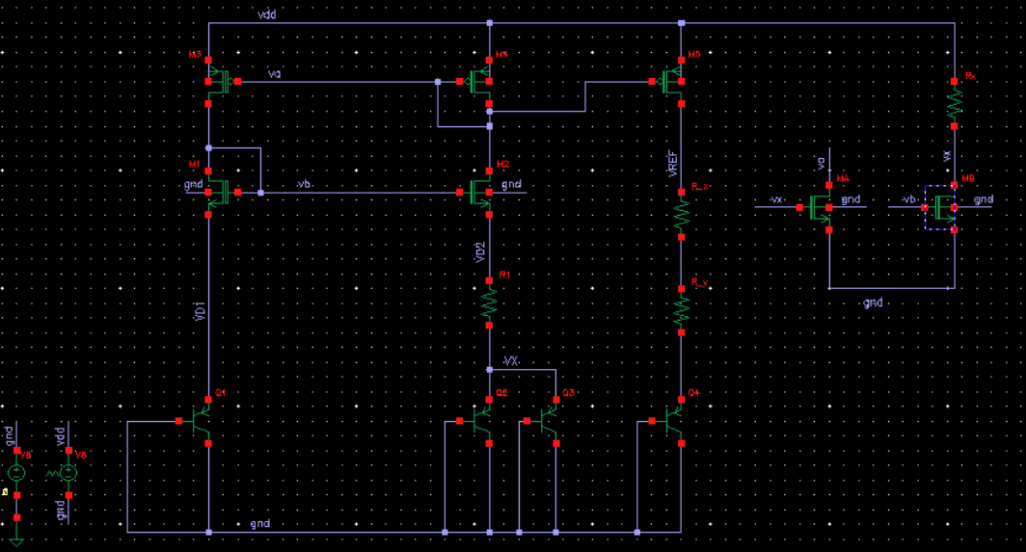
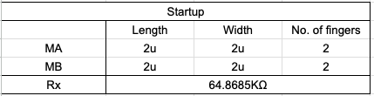
Schematic - Current mirror based BGR with Startup
Startup Circuit

Slide 14
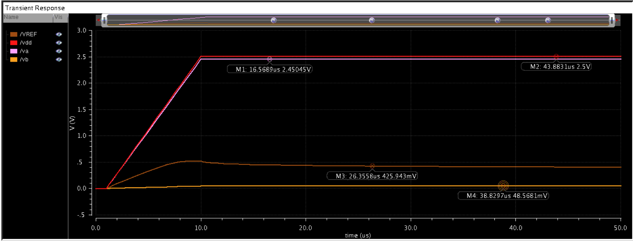
Before Startup

Slide 15
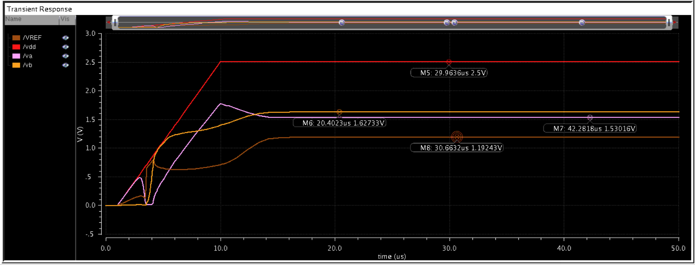
After Startup

Slide 16
Why we prefer Op-Amp based BGR
Here, Op-amp with enough gain will try to make V_{a}=V_{b}, which will make same current flow in R₁ branch and Q₁ branch
Sign of Op-Amp:
Here Op-Amp is connected in negative feedback as Drain of M2 changes oppositely with Op-Amp output.

Slide 17
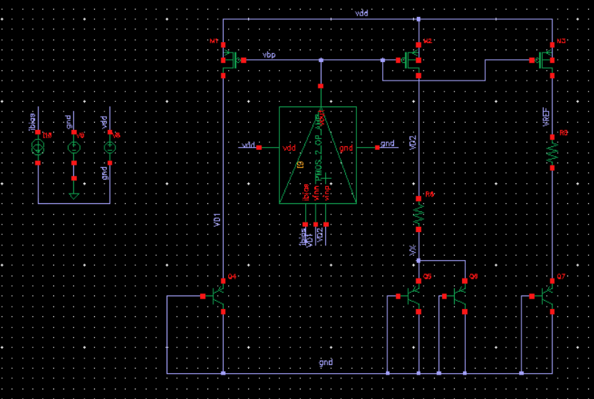
Op-Amp based BGR
Here the input to the Op-Amp itself less than half of VDD, the ICMR⁻ of NMOS Op-Amp will not meet this specification, so we are going with PMOS Op-Amp
Here ibias is 40uA and VDD is 2.5V from the designed Op-Amp
Here
R1 = 3.628KΩ
R2 = 97.302KΩ
And the sizes of Mosfet’s are

Slide 18
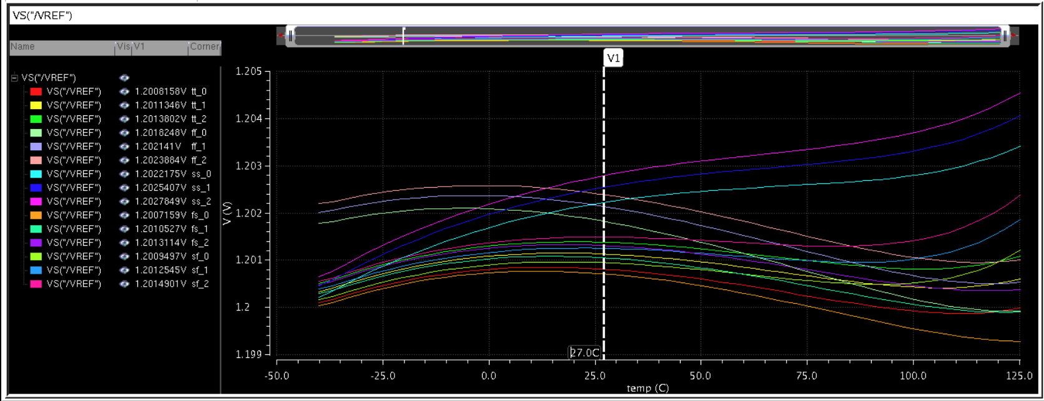
Simulation - DC (Op-Amp based BGR)
VREF is varying less than 1% across PVT from its typical value 1.201V in tt_27C_2.5V corner

Slide 19
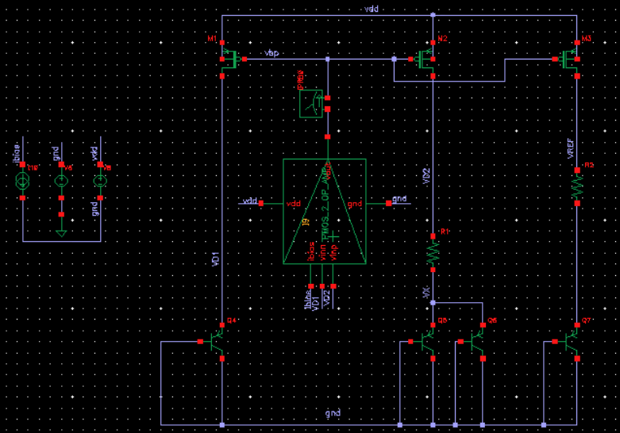
TestBench - Stability

Slide 20
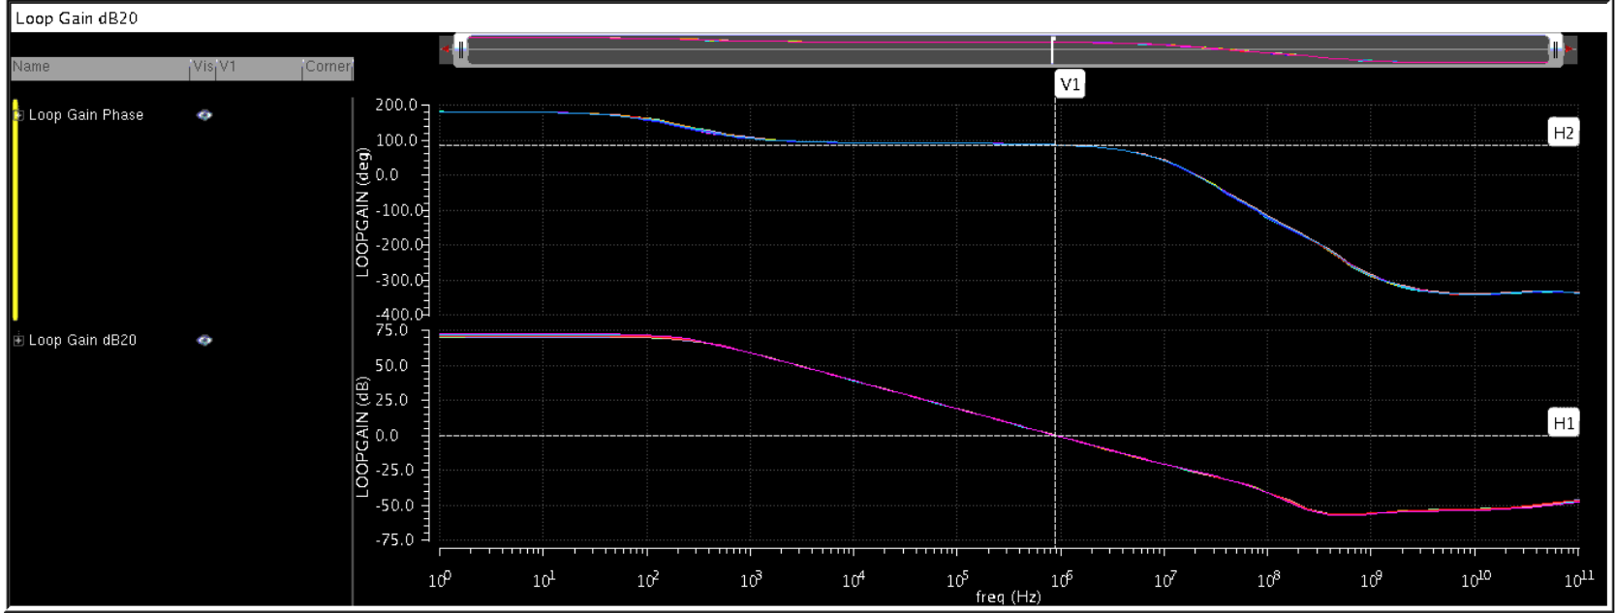

Results - Stability

Slide 21
TestBench - PSRR

Slide 22
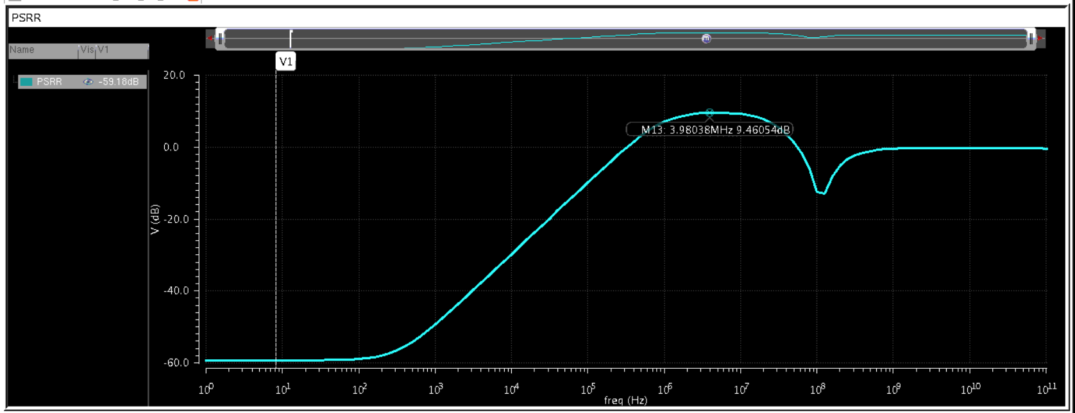
PSRR
The PSRR at higher frequency around 4GHz is going to 9.46dB, we want to reduce that.

Slide 23
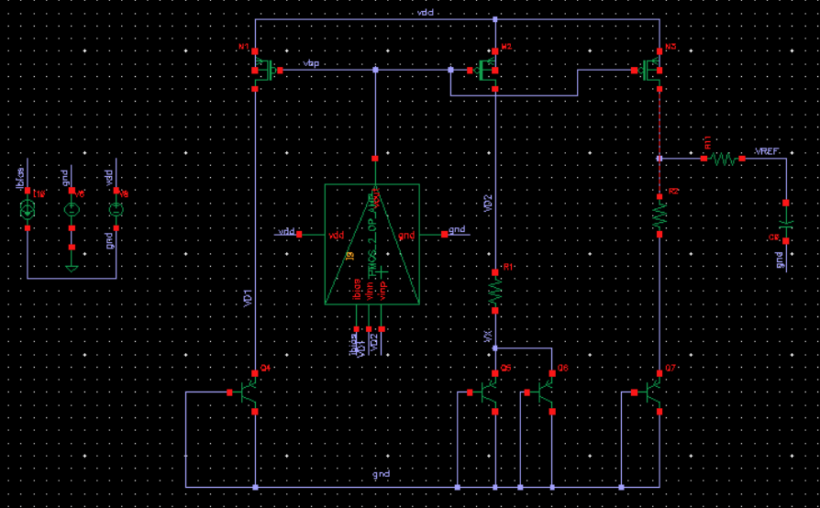
PSRR reduction at higher frequency
We are introducing an LPF at the VREF, so high frequency noise will get attenuated,
Here
R11 =1 KHz and C0 = 20pF

Slide 24
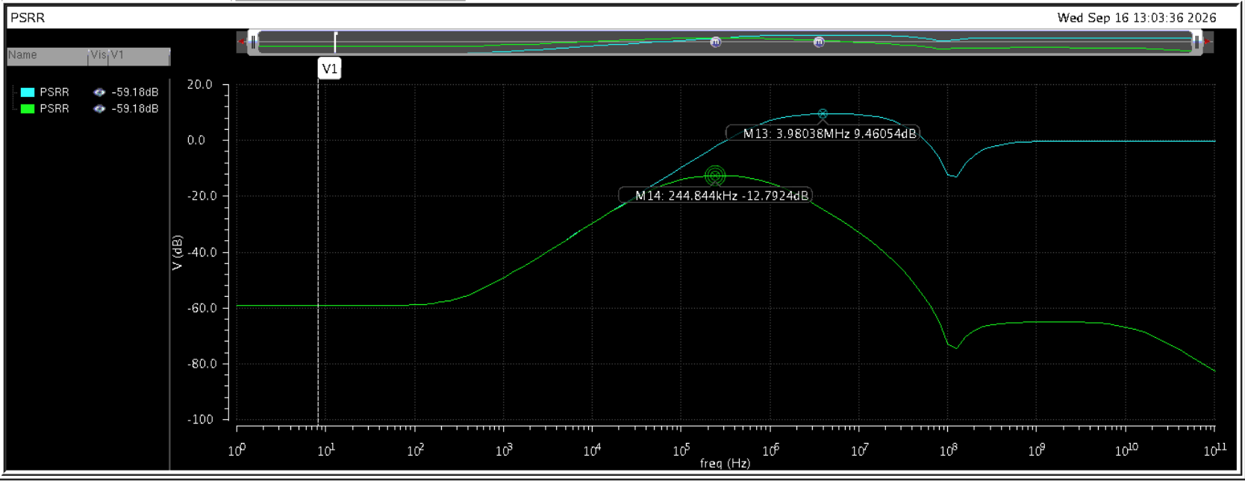
Change in PSRR because of introduced LPF
Here the the PSRR at high frequency got reduced a lot from 9.46dB

Slide 25
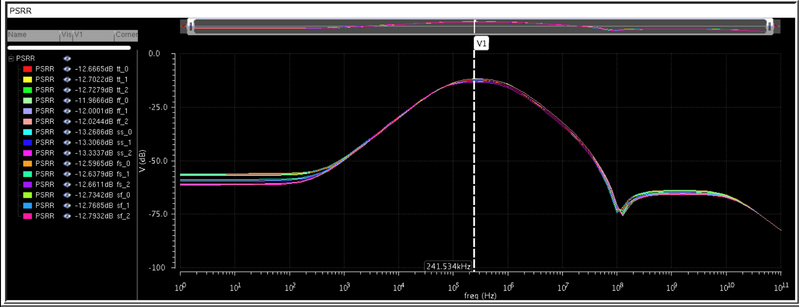
PSRR - PVT Results after introducing LPF at the output

Slide 26
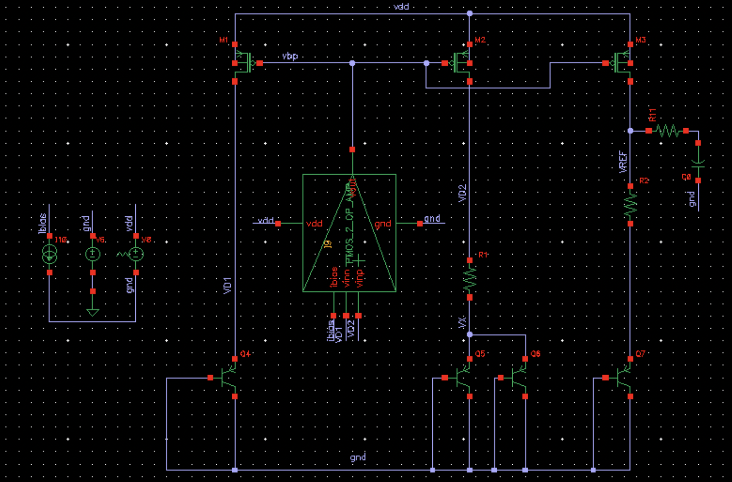
Transient Analysis - Schematic

Slide 27
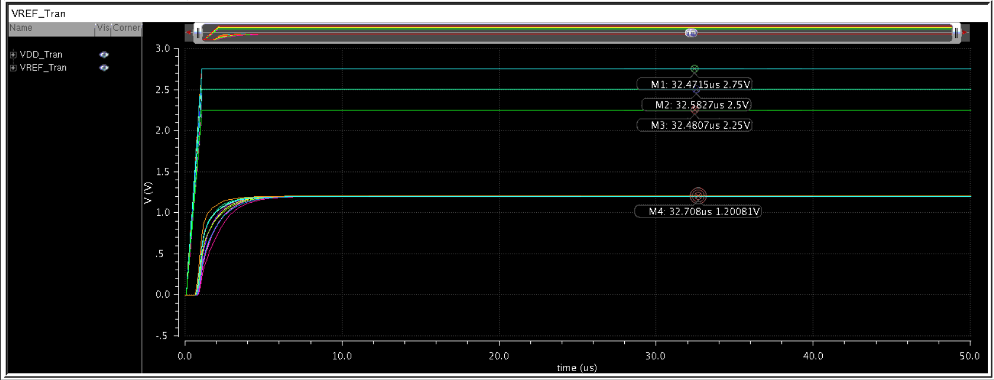
Transient Analysis - Results
VDD was went to 2.5V from 0V with in the span of 1us

Slide 28
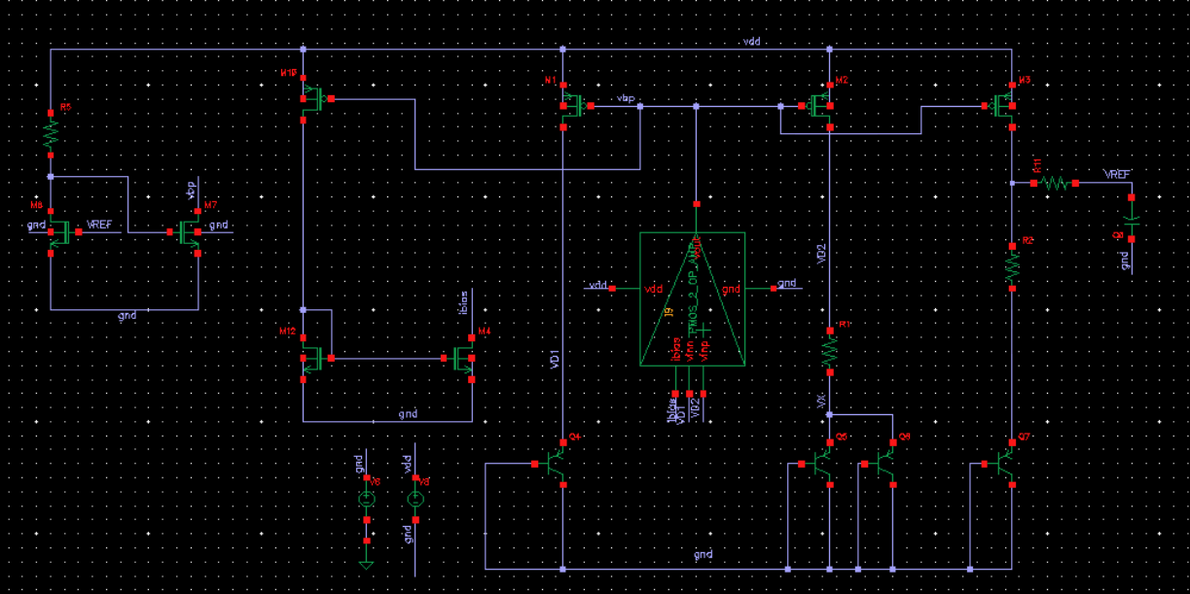
Startup and bias Circuit for Op-Amp based BGR

Slide 29
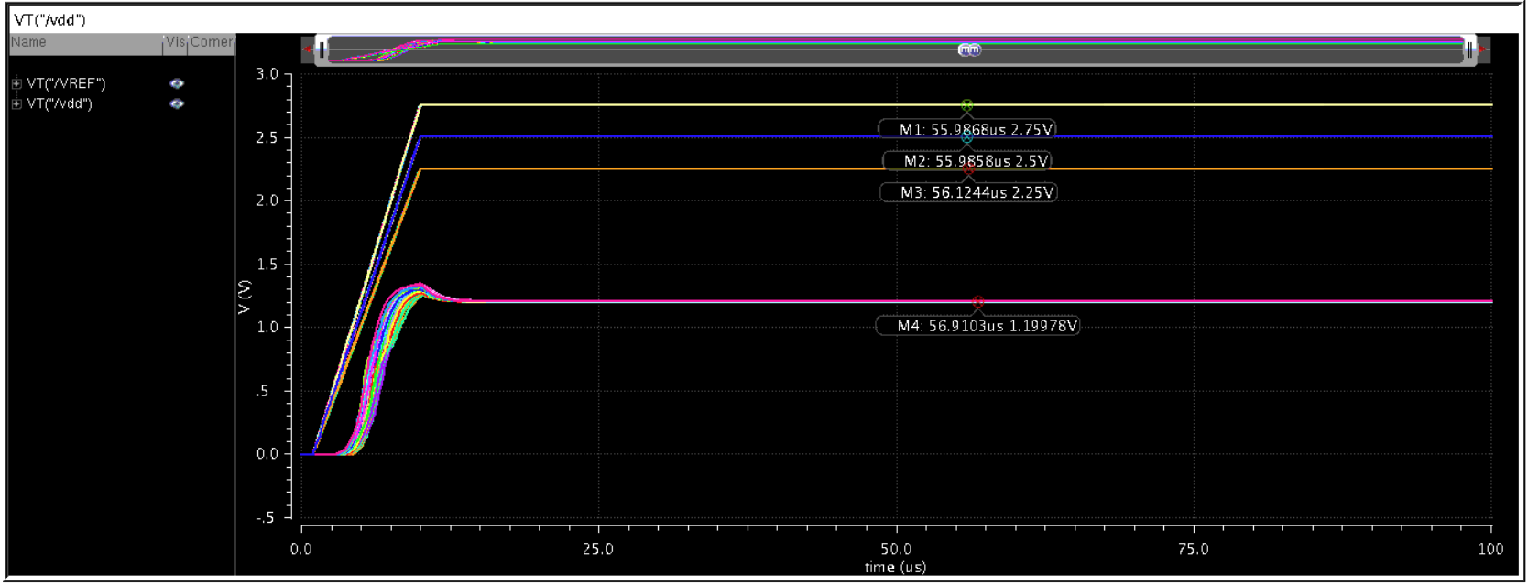
Transient Analysis - Results after Bias and startup Circuit

Slide 30
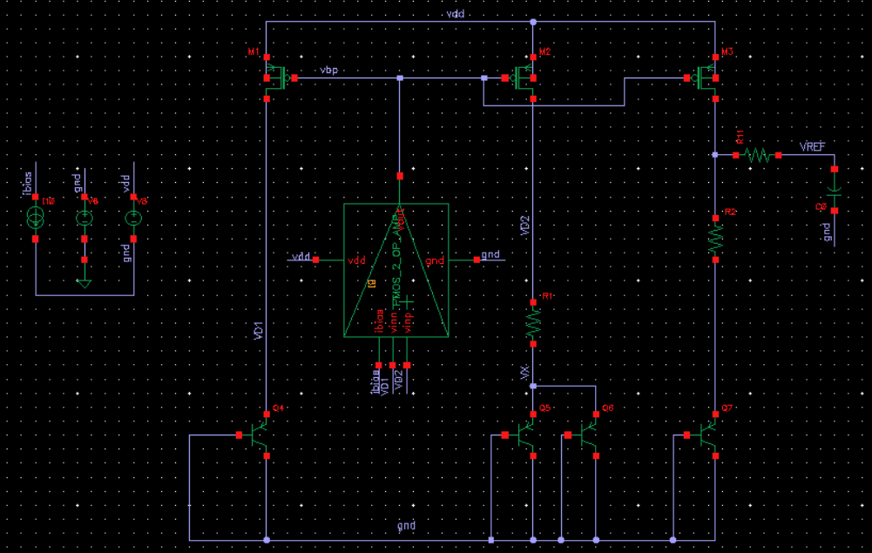
Testbench - Monte Carlo

Slide 31
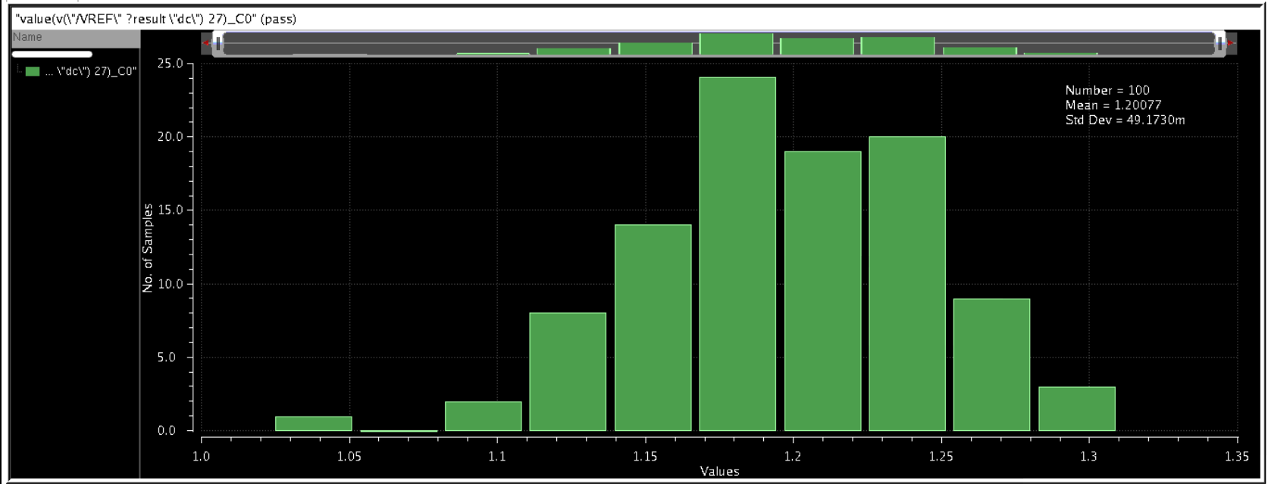
Monte carlo simulation - Mismatch

Slide 32
Thank you

